Slide 1
INF1004 Linear Algebra (Part II) Lecture 3: Linear Transformation

Slide 2
LEADING QUESTION
How can we apply Matrix Algebra into Engineering Applications and Solutions?
Heat Transfer?
Kinematics?
Robotics?
Image processing?
Machine learning and neural networks?

Slide 3
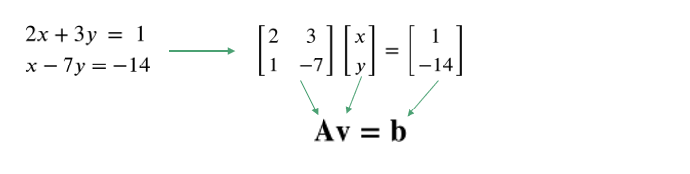
Recap: Matrix Notation of a System of Linear Eqns
A system of 2 linear equations can be written using matrices in the form:
where A is a matrix of coefficients, v is a vector of variables and b is a vector of constants.
One can say matrix A ‘transforms’ a vector v into another vector b. This is an example of a linear transformation in linear algebra.
3

Slide 4
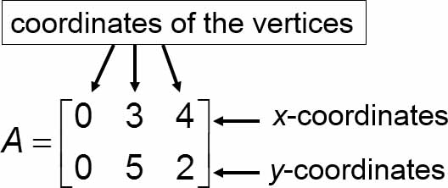
Applications: Transformation of an Image (1 of 6)
Consider the triangle represented by the matrix
Use matrix operations to move the triangle 3 units to the left and 1 unit down.

Slide 5
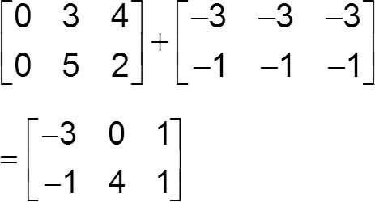
Transformation of an Image (2 of 6)
Solution:
We will subtract 3 from the x-coordinates (row 1) and subtract 1 from the y-coordinates (row 2).

Slide 6
Formal Definition of a Linear Transformation
A linear transformation, T: V ↦ U is one that takes an input vector space V and produces an output vector space U, such that it satisfies:
For any v₁, v₂ ∊ V and any scalar k ∊ ℝ,
T(v₁+v₂) = T(v₁)+T(v₂)
T(kv) = kT(v)
A linear transformation is also known as a linear mapping or linear function.

Slide 7

Exercise
Show that the function defined by T(v) = Av, where A is a 2 x 2 matrix, is a linear transformation.
Let $A=\left[\begin{matrix}a & b \\ c & d\end{matrix}\right],v=\left[\begin{matrix}x \\ y\end{matrix}\right]$,
$$Av=\left[\begin{matrix}a & b \\ c & d\end{matrix}\right]\left[\begin{matrix}x \\ y\end{matrix}\right]=x\left[\begin{matrix}a \\ c\end{matrix}\right]+y\left[\begin{matrix}b \\ d\end{matrix}\right]$$
Av is a linear combination of the columns of matrix A.
So, $T(v)=Av$ is a linear transformation.

Slide 8
Transformation of an Image (3 of 6)
Consider the triangle represented by the matrix
Use matrix operations to enlarge the triangle to twice its original perimeter.

Slide 9
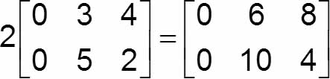
Transformation of an Image (4 of 6)
Solution:
We will multiply the original matrix by 2.
This will enlarge the triangle to twice its original perimeter.

Slide 10
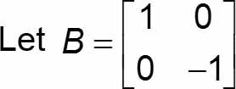
Transformation of an Image (5 of 6)
Consider the triangle represented by the matrix
Find BA. What effect does this have on the original triangle?

Slide 11
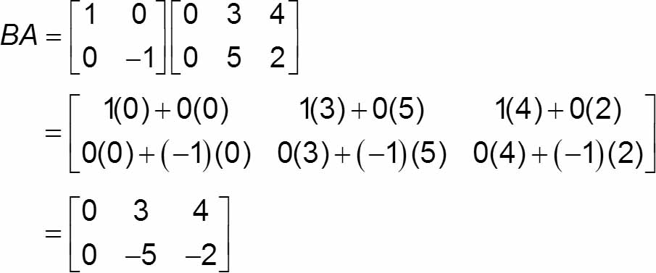
Transformation of an Image (6 of 6)
Solution:
Multiplication by B reflects the original triangle over the x-axis.

Slide 12

Inverse of a Linear Transformation
Similar to the inverse of a function, the inverse of a linear transformation might exist such that:
which follows the definition of an inverse given by:
T(v) = Av
vector v
vector u
T⁻¹(u) = A⁻¹u

Slide 13

Inverse of a Matrix (recap)
A square n x n matrix A is called invertible if there exist a square n x n matrix A⁻¹ such that:
where I is the identity matrix and A⁻¹ is known as the inverse of matrix A given by:
A_{adj} is known as the adjugate (or adjoint) of matrix A given by the transpose of its cofactor matrix.

Slide 14

Inverse of a Matrix
For a 2 x 2 matrix A, its inverse is given by:
Example: Determine the inverse of and check using the definition of the inverse. In layman, what does the inverse of A do?

Slide 15

Inverse of a Matrix
Example: Determine the inverse of and check using the definition of the inverse. In layman, what does the inverse of A do?
$A=\left[\begin{matrix}3 & 1 \\ 0 & 3\end{matrix}\right]$
$A^{−1}=\frac{1}{det(A)}A_{adj}=\frac{1}{3(3)−1(0)}\left[\begin{matrix}3 & −1 \\ 0 & 3\end{matrix}\right]=\left[\begin{matrix}\frac{3}{9} & −\frac{1}{9} \\ 0 & \frac{3}{9}\end{matrix}\right]=\left[\begin{matrix}\frac{1}{3} & −\frac{1}{9} \\ 0 & \frac{1}{3}\end{matrix}\right]$
Inverse of a matrix is like a reciprocal for numbers. The product of a matrix and its inverse matrix is equal to the unit matrix.

Slide 16

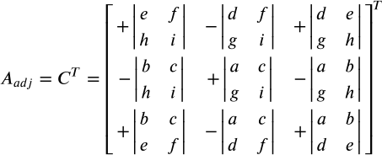
Inverse of a Matrix
For a 3 x 3 matrix A, obtaining its inverse is much more tedious, from:
where C is known as the cofactor matrix.
A square matrix is singular or not invertible if its determinant is 0

Slide 17
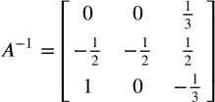

Inverse of a Matrix
Example: Determine the inverse of the matrix below and check using the definition of the inverse.
$$A=\left[\begin{matrix}1 & 0 & 1 \\ 2 & −2 & −1 \\ 3 & 0 & 0\end{matrix}\right]$$
$$A_{adj}=C^{T}={\left[\begin{matrix}+\left|\begin{matrix}−2 & −1 \\ 0 & 0\end{matrix}\right| & −\left|\begin{matrix}2 & −1 \\ 3 & 0\end{matrix}\right| & +\left|\begin{matrix}2 & −2 \\ 3 & 0\end{matrix}\right| \\ −\left|\begin{matrix}0 & 1 \\ 0 & 0\end{matrix}\right| & +\left|\begin{matrix}1 & 1 \\ 3 & 0\end{matrix}\right| & −\left|\begin{matrix}1 & 0 \\ 3 & 0\end{matrix}\right| \\ +\left|\begin{matrix}0 & 1 \\ −2 & −1\end{matrix}\right| & −\left|\begin{matrix}1 & 1 \\ 2 & −1\end{matrix}\right| & +\left|\begin{matrix}1 & 0 \\ 2 & −2\end{matrix}\right|\end{matrix}\right]}^{T}={\left[\begin{matrix}−2(0)−(−1)(0) & −[2(0)−(−1)(3)] & 2(0)−(−2)(3) \\ 0 & 1(0)−1(3) & −[1(0)−3(0)] \\ 0(−1)−(1)(−2) & −[1(−1)−1(2)] & 1(−2)−0\end{matrix}\right]}^{T}={\left[\begin{matrix}0 & −3 & 6 \\ 0 & −3 & 0 \\ 2 & 3 & −2\end{matrix}\right]}^{T}=\left[\begin{matrix}0 & 0 & 2 \\ −3 & −3 & 3 \\ 6 & 0 & −2\end{matrix}\right]$$
$$det(A)=1(−2)(0)+0(−1)(3)+1(2)(0)−1(−1)(0)−0(2)(0)−1(−2)(3)=6$$
$$A^{−1}=\frac{1}{det(A)}A_{adj}=\frac{1}{6}\left[\begin{matrix}0 & 0 & 2 \\ −3 & −3 & 3 \\ 6 & 0 & −2\end{matrix}\right]=\left[\begin{matrix}0 & 0 & \frac{1}{3} \\ −\frac{1}{2} & −\frac{1}{2} & \frac{1}{2} \\ 1 & 0 & −\frac{1}{3}\end{matrix}\right]$$
ANS:

Slide 18
Linear equations
Although matrices are of great importance in themselves, their practical importance lies in the solution of sets of linear equations.
Remember:
can be written as:
We know that A⁻¹ exists, and hence:
Matlab Code: x = inv(A)*b
https://www.mathworks.com/help/matlab/ref/inv.html

Slide 19
Example 17
Find a solution of

Slide 20
Solution
We can write the linear equations in matrix notation

Slide 23
Cramer’s rule
Cramer’s rule states that if
Determinant of a square matrix is a scalar that represents the area scale factor of a Linear Transformation in R²
Then , where

Slide 24
Example 18
Find a solution of

Slide 25
Solution

Slide 27
Gaussian Elimination
Another way to solve the system of linear equations is by using Gaussian elimination.
Step-by-step Procedure
Write the equations in a matrix form of Ax = b
Form an augmented matrix
Systematic elimination by forward elimination (row transformations)
Systematic substitution by back substitution

Slide 28
Augmented Matrix
The first step in solving a system of equations using matrices is to represent the system of equations with an augmented matrix.
An augmented matrix consists of two smaller matrices, one for the coefficients of the variables and one for the constants.
To determine the augmented matrix, first write each equation in standard form, ax + by = c.
Systems of Equations
Augmented Matrix
a₁x + b₁y = c₁
a₂x + b₂y = c₂
a₁x + b₁y + c₁z = d₁
a₂x + b₂y + c₂z = d₂
a₃x + b₃y + c₃z = d₃

Slide 29
Augmented Matrix
Systems of Equations
Augmented Matrix
x + 2y = 8
3x – y = 7

Slide 30
Row Transformations
To solve a system of equations by using matrices, we use row transformations to obtain new matrices that have the same solution as the original system.
We use row transformations to obtain an augmented matrix whose numbers to the left of the vertical bar are the same as the multiplicative identity matrix.
From this type of augmented matrix, we can determine the solution to the system of equations.
E.g., if we get
it tells us that 0x + 1y = 7 and 1x + 2y = 8. Thus the solution is y = 7, x= -6

Slide 31
Any two rows of a matrix may be interchanged.
All the numbers in any row may be multiplied by any nonzero number.
All the numbers in any row may be multiplied by any nonzero number, and these products may be added to the corresponding numbers in any other row of numbers.
MATLab code: x = A\b. This produces the solution using Gaussian elimination, without explicitly forming the inverse.
https://www.mathworks.com/help/matlab/ref/mldivide.html

Slide 32
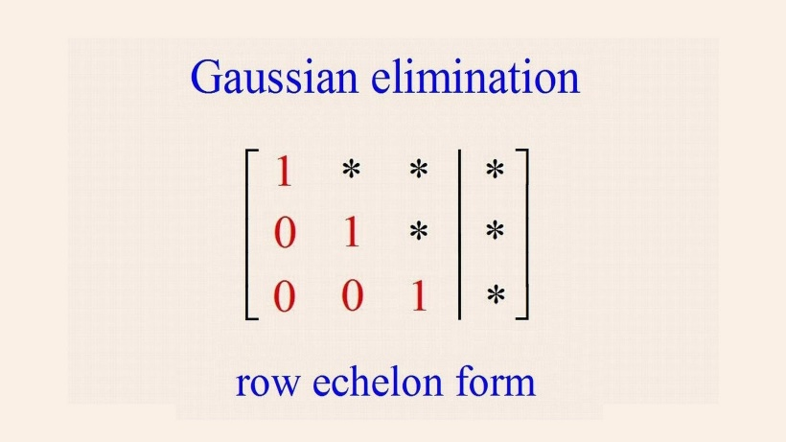
Any two rows of a matrix may be interchanged.
All the numbers in any row may be multiplied by any nonzero real number.
All the numbers in any row may be multiplied by any nonzero real number, and these products may be added to the corresponding numbers in any other row of numbers.
MATLab code: x = A\b. This produces the solution using Gaussian elimination, without explicitly forming the inverse.
https://www.mathworks.com/help/matlab/ref/mldivide.html

Slide 33
Example 19
Find a solution of

Slide 34
Solution
1. Write the equation in a matrix form of Ax = b
2. Form an augmented matrix

Slide 35
3. Systematic elimination by forward elimination (row transformations)
swap row 1 & row 3
Eliminate a₂₁ & a₃₁
3*R1 ‒ R2
2*R1 ‒ R3
Eliminate a₃₂
R2 ‒ R3

Slide 36
4. Systematic substitution by back substituton

Slide 37
Example 20 (class exercises)
Find a solution of

Slide 38
Solution
1. Write the equation in a matrix form of Ax = b
2. Form an augmented matrix

Slide 39
3. Systematic elimination by forward elimination
Eliminate a₂₁ & a₃₁
2*R1 ‒ R2
3*R1 ‒ R3
Divide R2 by 2
Eliminate a₃₂
R2 ‒ R3

Slide 40
4. Systematic substitution by back substituton

Slide 41
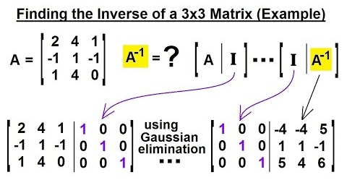
Gaussian Elimination for Inverse Matrix (optional)

Slide 42
Inconsistent Systems
An inconsistent system occurs when, after obtaining an augmented matrix, one row of numbers on the left side of the vertical line are all zeros but a zero does not appear in the same row on the right side of the vertical line.
This indicates that the system has no solution.
Inconsistent Systems

Slide 43
A System with No Solution
Systems of Equations
Augmented Matrix

Slide 44
A System with No Solution
Systems of Equations
Augmented Matrix

Slide 45
Dependent Systems
If a matrix is obtained and a 0 appears across an entire row, the system of equations is dependent.
Dependent Systems
If there are no rows with all zeros in the coefficient matrix, then all equations (rows) in the SLE are linearly independent
A unique solution occurs when all equations (rows) in the SLE are linearly independent, which means any one equation (row) cannot be expressed as a linear combination of the other equations

Slide 46
A System with Infinite Number of Solutions
Systems of Equations
Augmented Matrix

Slide 47

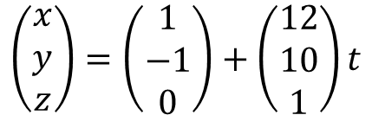
A System with Infinite Number of Solutions
Systems of Equations
Augmented Matrix
$$\left(\begin{matrix}x \\ y \\ z\end{matrix}\right)=\left(\begin{matrix}1 \\ −1 \\ 0\end{matrix}\right)+\left(\begin{matrix}12 \\ 10 \\ 1\end{matrix}\right)t$$

Slide 48
Summary of Solution Types
A system of linear equations has
no solution, or
exactly one solution, or
infinitely many solutions.
A system of linear equations is said to be consistent if it has either one solution or infinitely many solutions.
A system of linear equation is said to be inconsistent if it has no solution.

Slide 49
Summary of Solution Types
Unique Solution (Consistent Systems):
Exactly one point given by the coordinates of intersection.
Occurs when all equations are linearly independent.
Infinite Solutions (Consistent Systems)
Infinite points given by the coordinates of intersection.
Occurs when some or all equations are not linearly independent.
No Solution (Inconsistent System)
No point of intersection.
Occurs when all equations are linearly dependent.

Slide 50
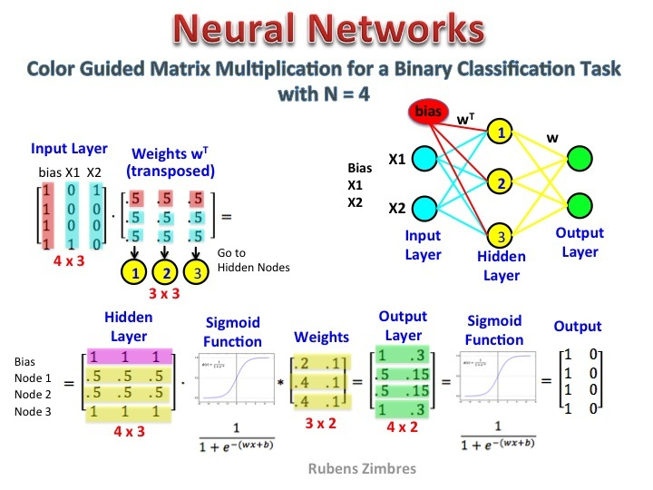
APPLICATIONS
https://www.datasciencecentral.com

Slide 51
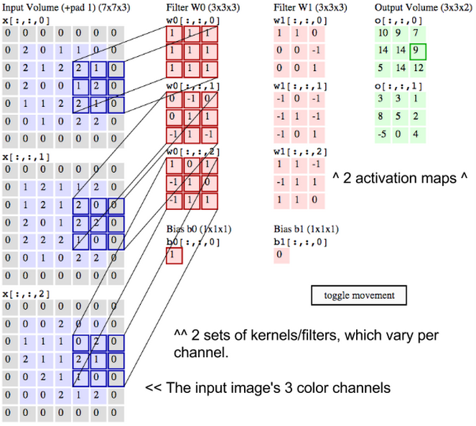
APPLICATIONS
https://deeplearning4j.org

Slide 52
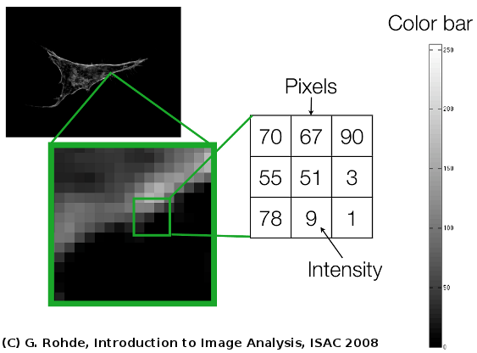
APPLICATIONS
Image Processing

Slide 53
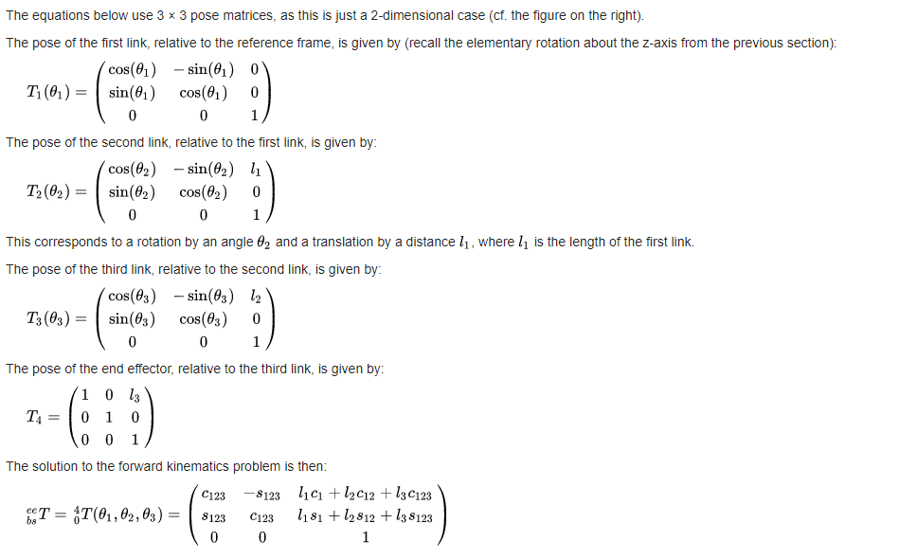
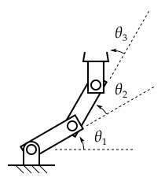
APPLICATIONS
Image Processing
Robotics Kinematics

Slide 54
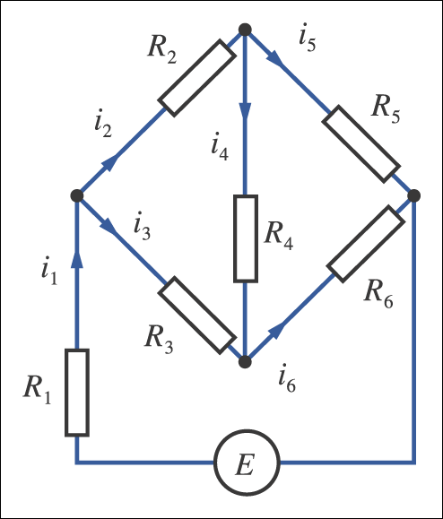
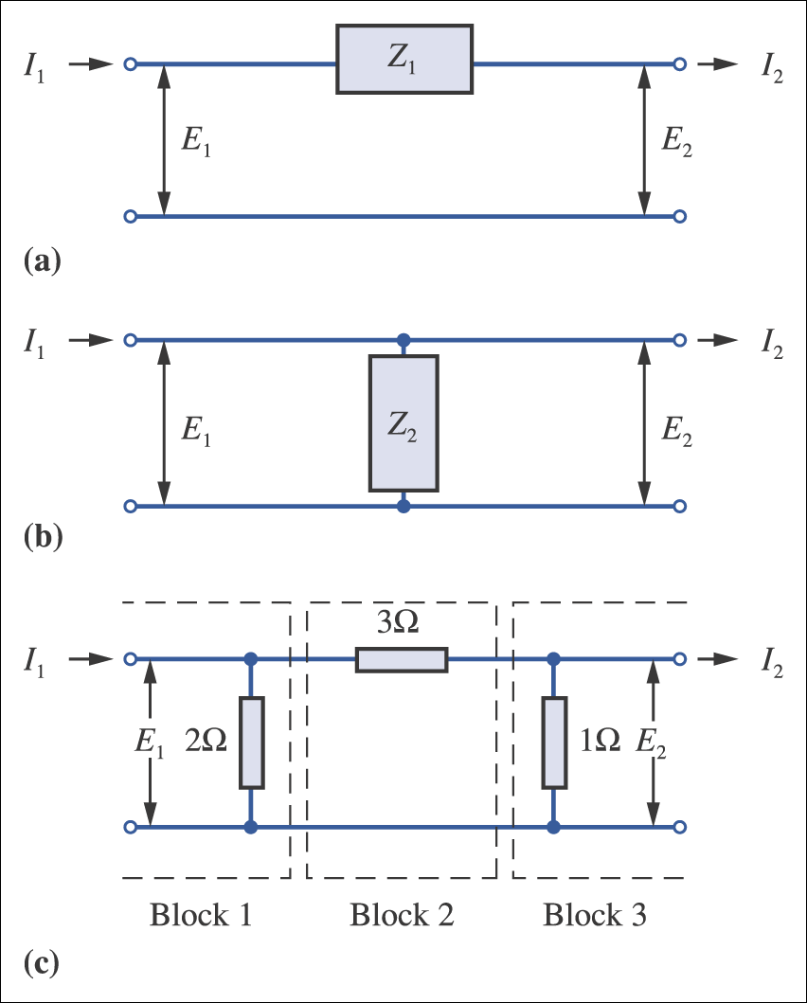
APPLICATIONS
Electric Circuits

Slide 55
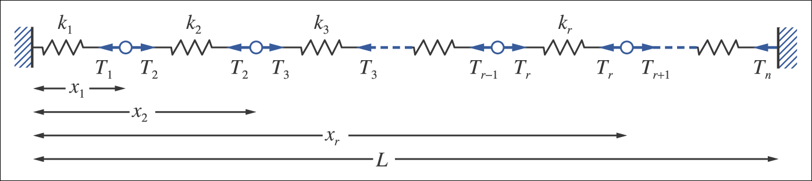
APPLICATIONS
n-particle system from textbook

Slide 56
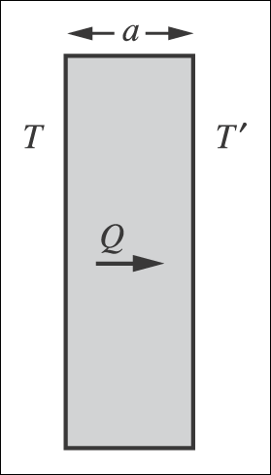
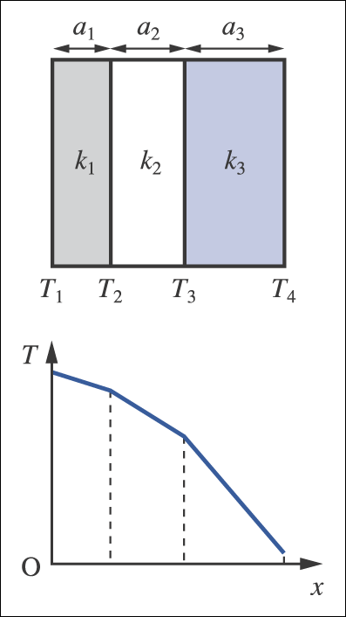
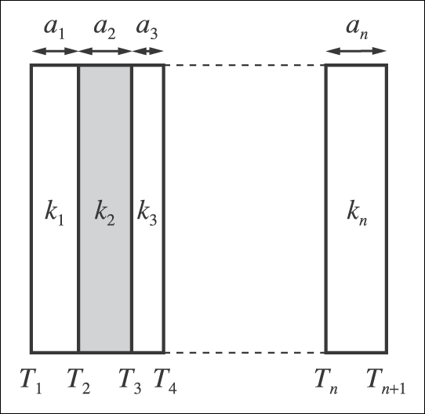
APPLICATIONS
Multiple layer of heat transfer from textbook

Slide 57
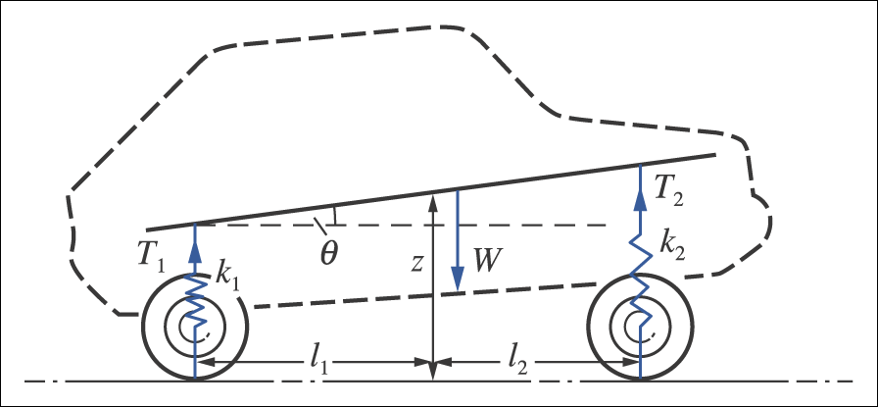
APPLICATIONS
Car at rest on horizontal ground from textbook

